Slide 1
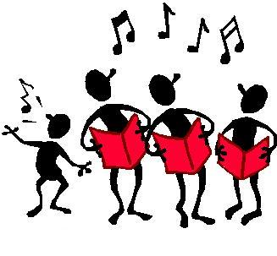
We can sing all our sounds. Skip to my lou my darling.

Slide 2
sh

Slide 3
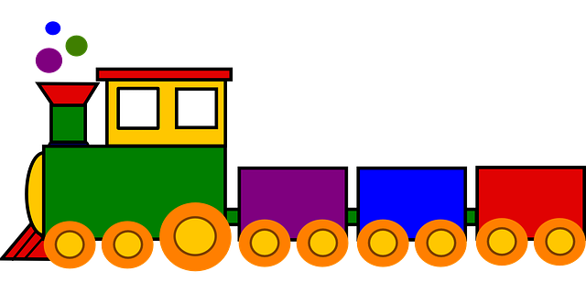
ch

Slide 4
th

Slide 5
Skip to my lou my darling.

Slide 6
ng

Slide 7
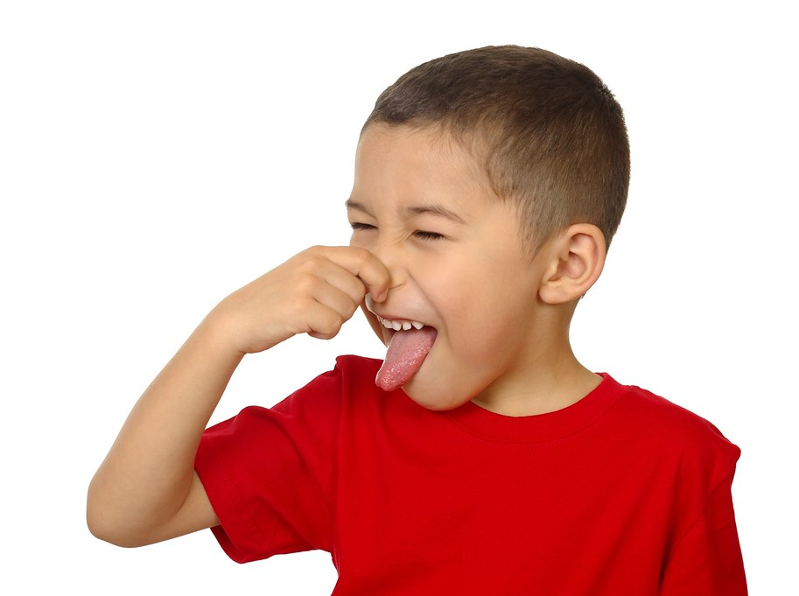
nk

Slide 8
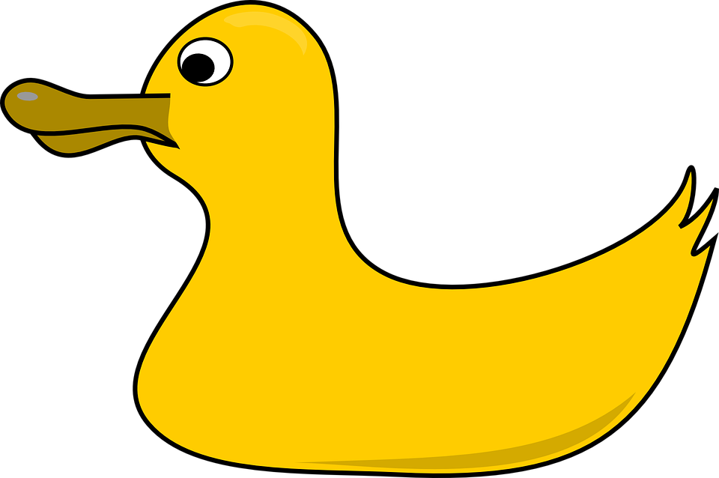
qu

Slide 9
Skip to my lou my darling.

Slide 10
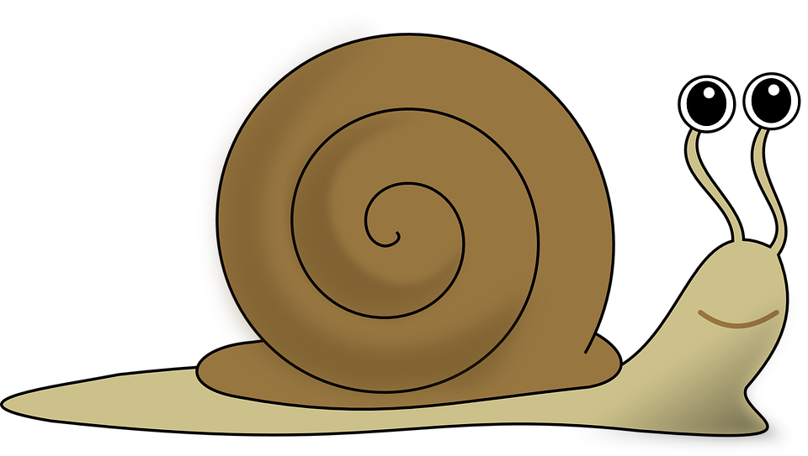
ai

Slide 11
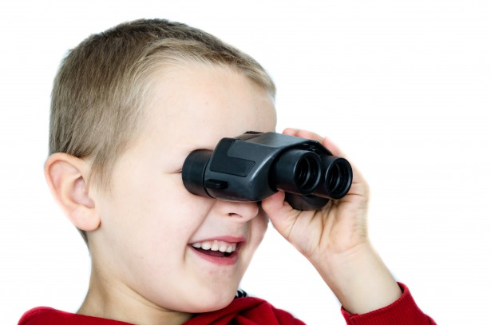
ee

Slide 12
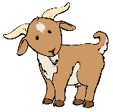
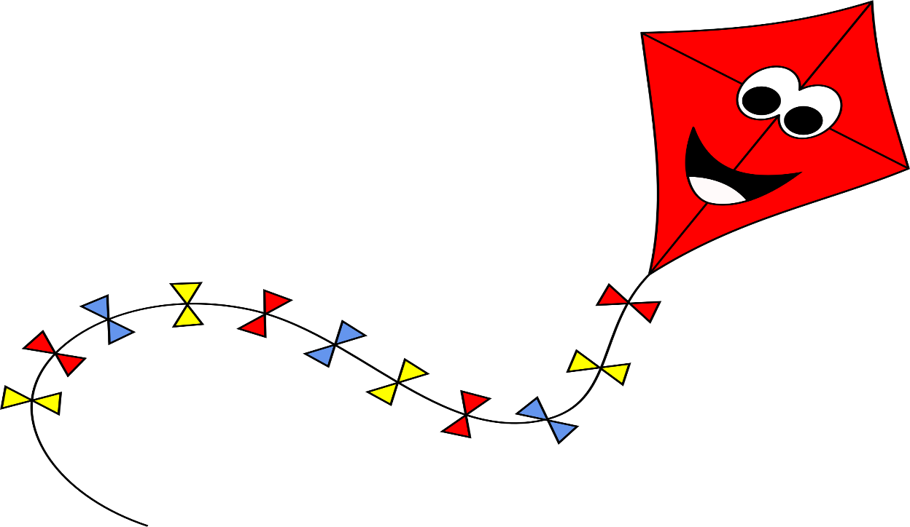
igh

Slide 13
Skip to my lou my darling.

Slide 14
oa

Slide 15
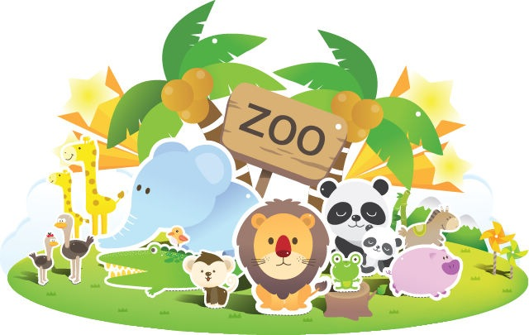
oo

Slide 16
oo

Slide 17
Skip to my lou my darling.

Slide 18
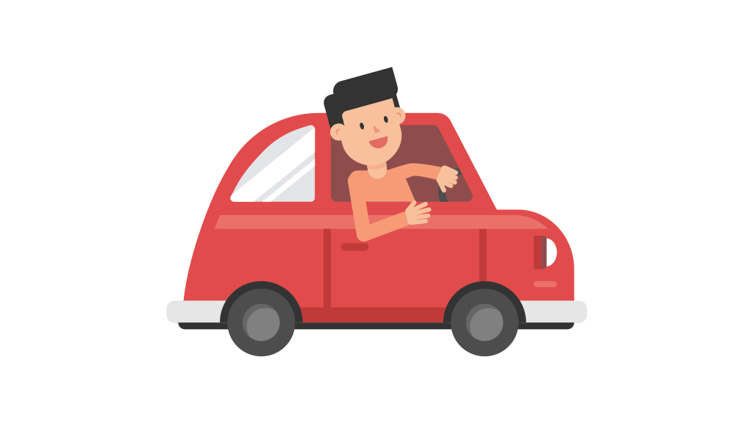
ar

Slide 19
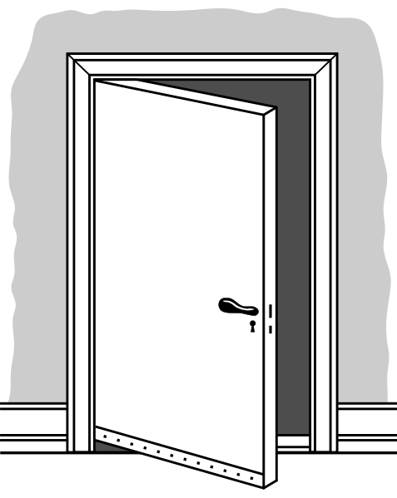
or oor

Slide 20
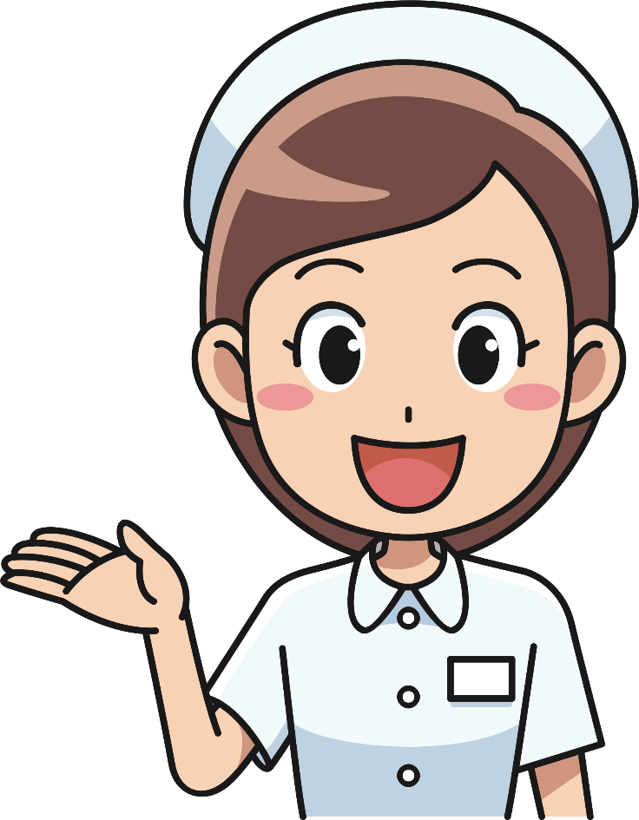
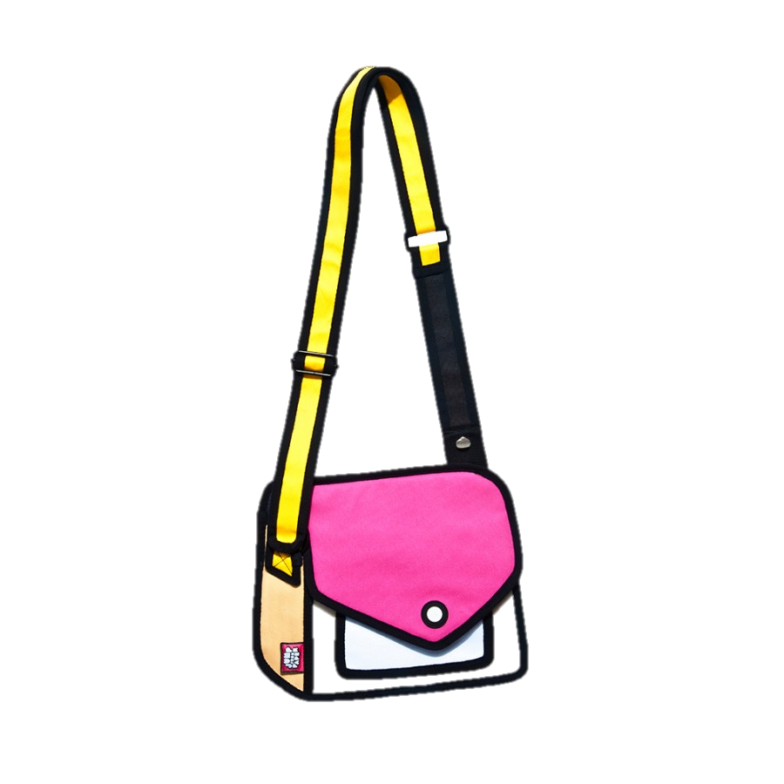
ur

Slide 21
Skip to my lou my darling.

Slide 22
er

Slide 23
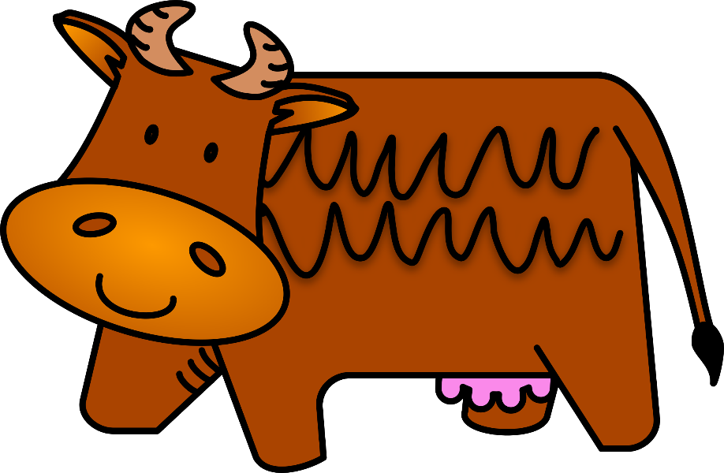
ow

Slide 24
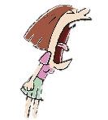
ou

Slide 25
Skip to my lou my darling.

Slide 26
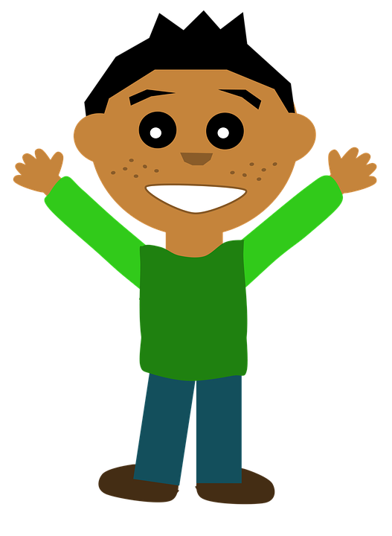
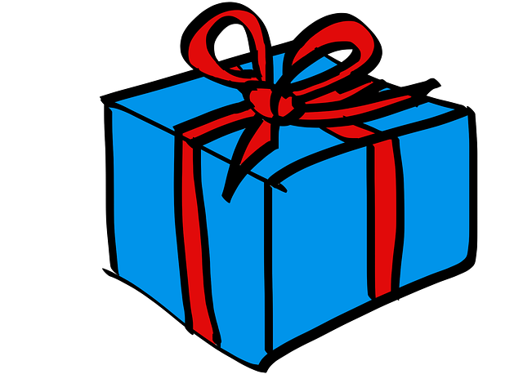
oi

Slide 27
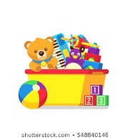
oy

Slide 28
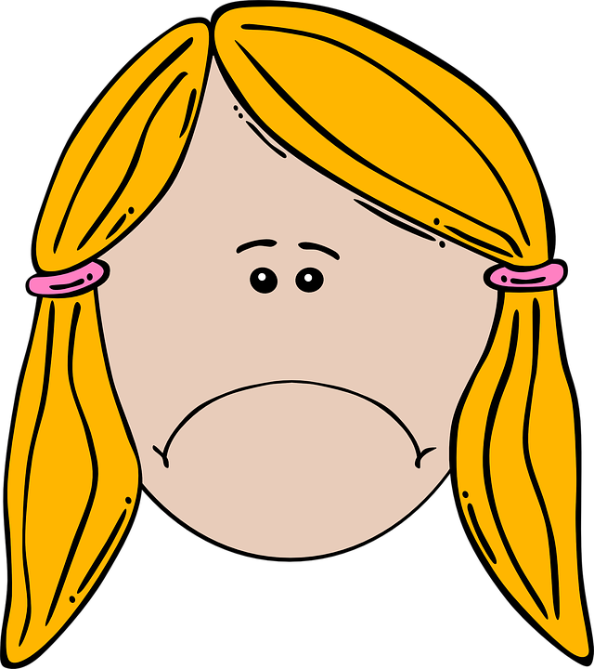
air

Slide 29
Skip to my lou my darling.

Slide 30
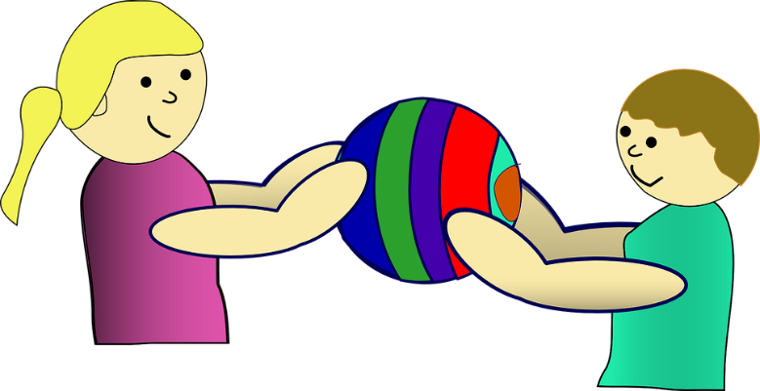
are

Slide 31
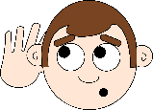
ear

Slide 32
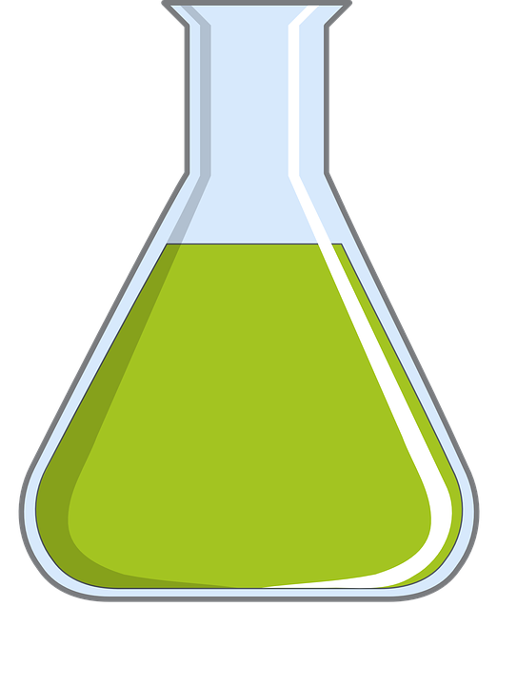
ure

Slide 33
Skip to my lou my darling.

