Slide 1


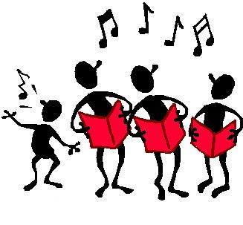
We can sing all our sounds.
Skip to my lou my darling.

Slide 2
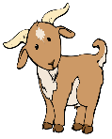

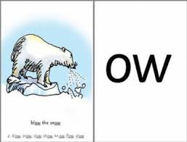
ow
oa

Slide 3

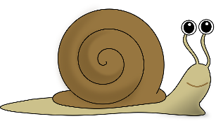
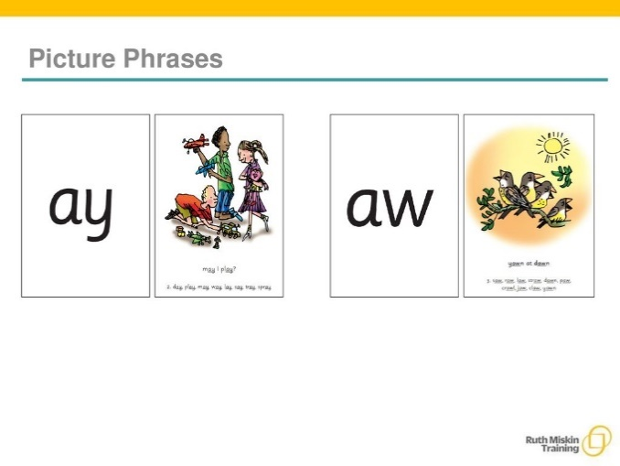
ay
ai

Slide 4
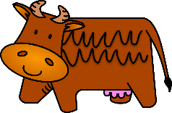
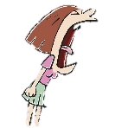
ou
ow

Slide 5
Skip to my lou my darling.

Slide 6
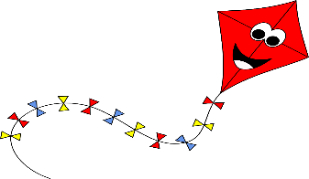
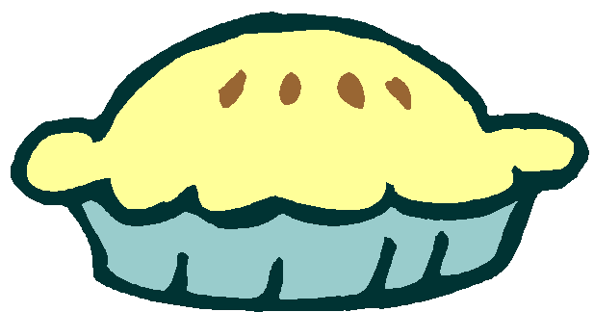
ie
igh

Slide 7


ea
ee

Slide 8


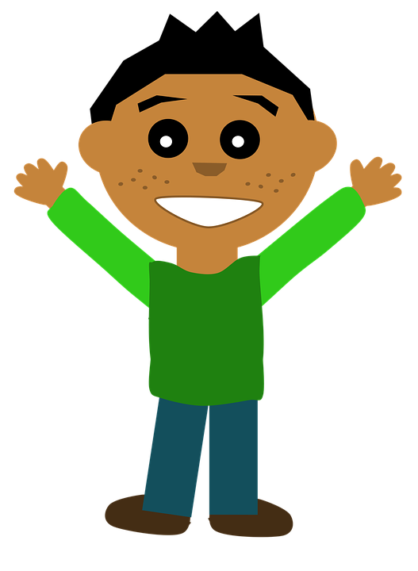
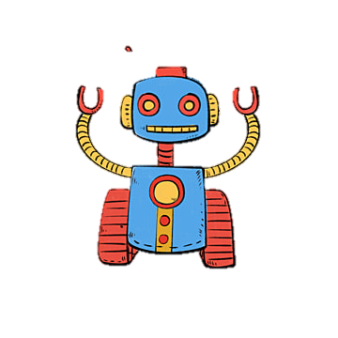
oy
oi

Slide 9
Skip to my lou my darling.

Slide 10

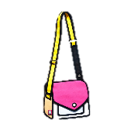

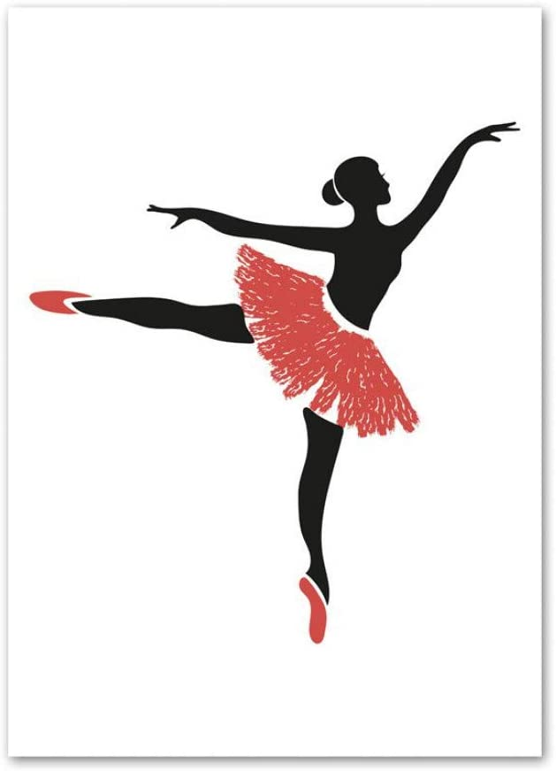
ir
er
ur

Slide 11
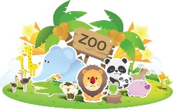
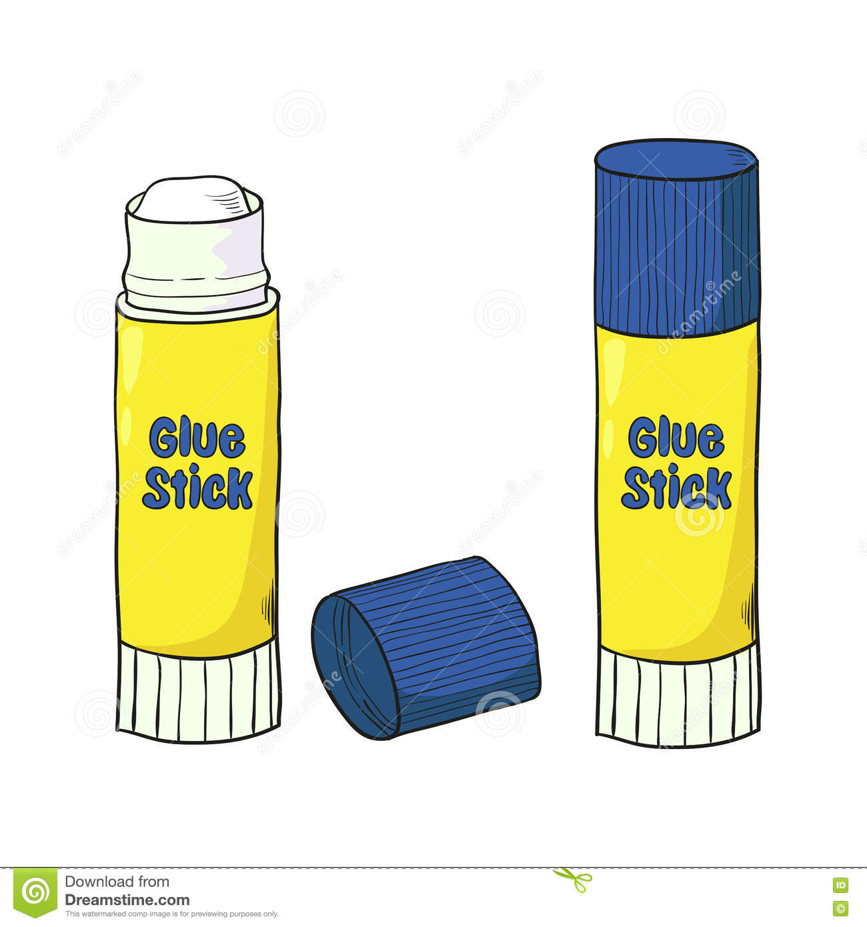
ue
oo

Slide 12
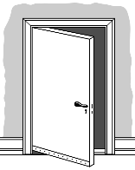
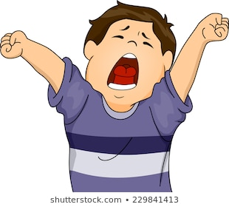
aw
oor

Slide 13
Skip to my lou my darling.

Slide 14
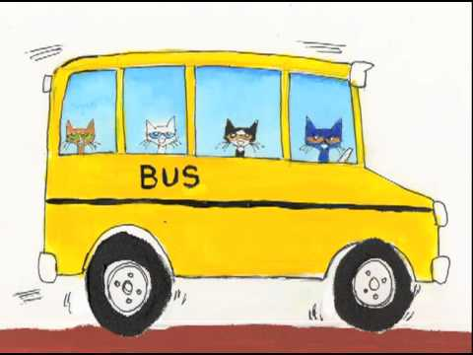
wh

Slide 15
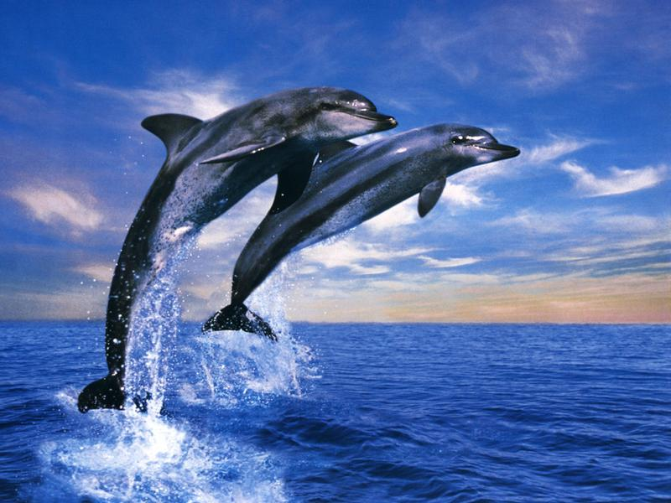

ph

Slide 16

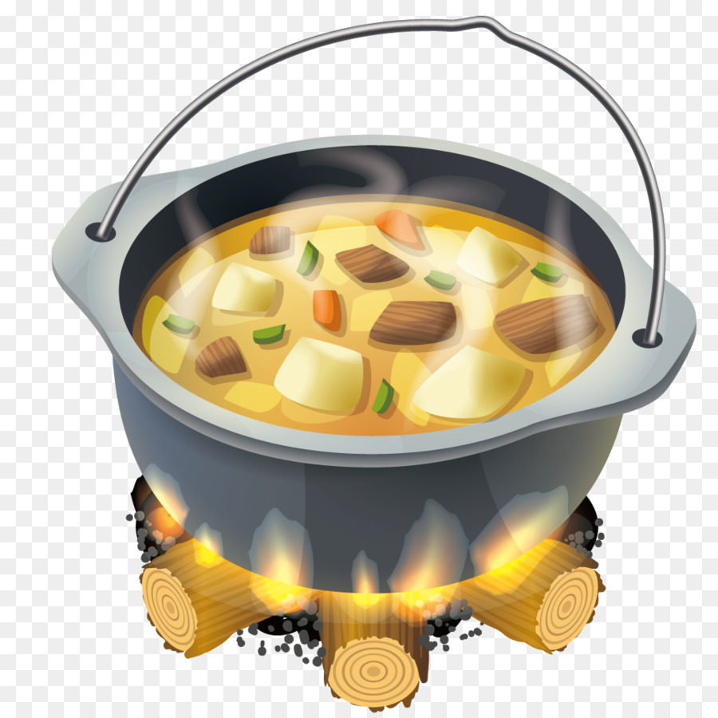
ew
oo
ue

Slide 17
Skip to my lou my darling.

Slide 18
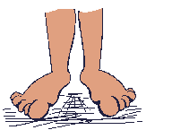
oe
oa
ow

Slide 19

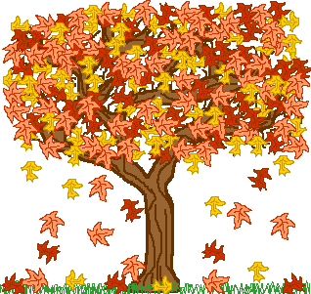
au
oor
aw

Slide 20
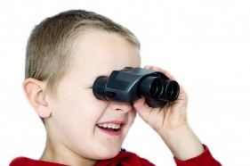

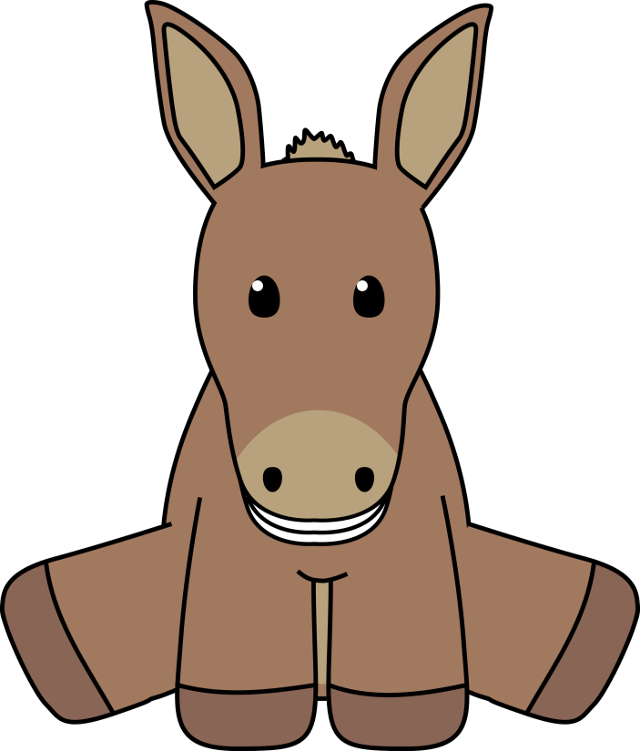

ey
ee
ea

Slide 21
Skip to my lou my darling.

Slide 22


a-e
ai
ay

Slide 23

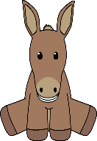


e-e
ee
ea
ey

Slide 24

i-e
ie
igh

Slide 25
Skip to my lou my darling.

Slide 26

o-e
oa
ow
oe

Slide 27


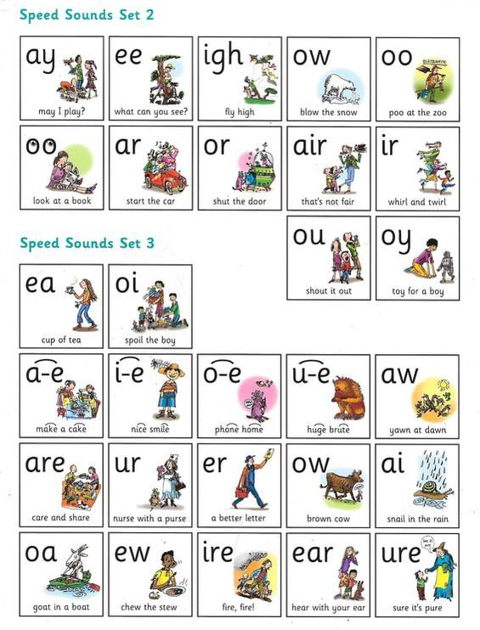
u-e
oo
ew
ue

Slide 28

ire

Slide 29
Skip to my lou my darling.

Slide 30
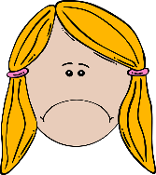
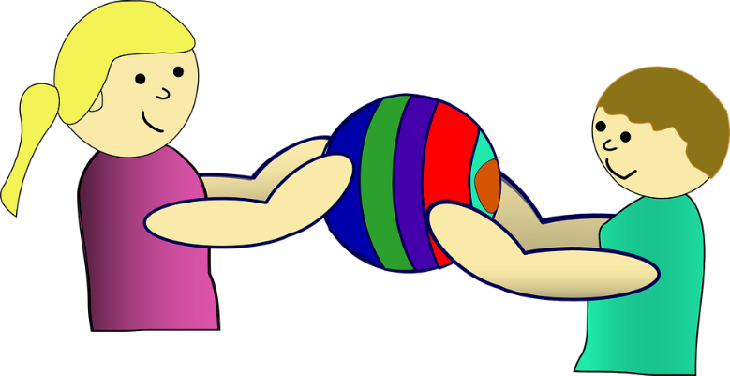
are
air

Slide 31
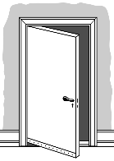
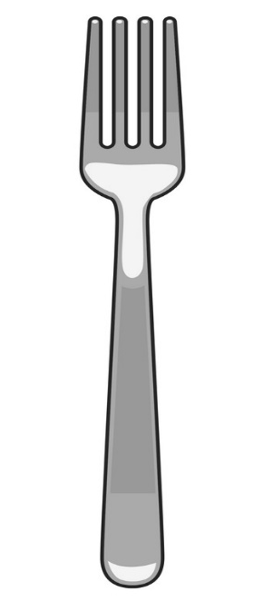
or
oor
aw
au

